Slide 1


Formal Definition of Deterministic Finite Automata (DFA) Session No.: 3 Course Name: Theory of Computation Course Code: R1UC501T Instructor Name: Dr. Avaneesh Yadav Duration: 50 mins Date of Conduction of Class: 26/08/2025

Slide 2

Review of the key concepts of session no. #2
Introduction to Finite State Machine with example
Real-life example of a Finite State Machine

Slide 3
Pre-Session Quiz
Attempt all question of pre-lesson assessment

Slide 4


Opening: Engaging Questions “What is the meaning of deterministic?”
Example??
Discuss

Slide 5
At the end of this session, you will be able to:
Learning Outcome 1: construct and analyze DFA
Learning Outcome 2: Differentiate DFA with other Automata Models

Slide 6
Session Outline
Recap
Opening Questions
Formal Definition of DFA
Activity 1
Conclusion

Slide 7

Opening Question
What is the meaning of deterministic?

Slide 8
Formal Definition of DFA
DFA refers to deterministic finite automata.
Deterministic refers to the uniqueness of the computation.
The finite automata are deterministic FA, if the machine reads an input string one symbol at a time.
In DFA, there is only one path input from the current state to the next state.
It does not accept the null move, i.e. it cannot change state without any input.
It can contain multiple final states. It is used in Lexical Analysis in compilers.

Slide 9
Formal Definition of a DFA
A Deterministic Finite Automata (DFA) is a collection of defined as a 5-tuple and is as follows −
M=(Q,Σ,δ,q0,F)
where,
Q is a finite set of states.
∑ is a finite set of symbols calling the alphabet.
δ is the transition function where δ: Q × ∑ → Q
q₀ is the initial state from where any input is processed (q₀ ∈ Q).
F is a set of final state/states of Q (F ⊆ Q).

Slide 10
Graphical Representation of a DFA
A DFA is represented by digraphs called state diagram.
The vertices represent the states.
The arcs labeled with an input alphabet show the transitions.
The initial state is denoted by an empty single incoming arc.
The final state is indicated by double circles.

Slide 11
Example 1
Let a deterministic finite automaton be →
Q = {a, b, c},
∑ = {0, 1},
q₀ = {a},
F = {c}, and
Transition Table
Transition function δ as shown by the following table −
Present State | Next State for Input 0 | Next State for Input 1
a | a | b
b | c | a
c | b | c

Slide 12
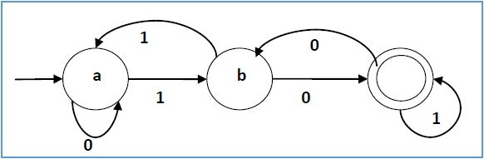
Its graphical representation would be as follows −

Slide 13
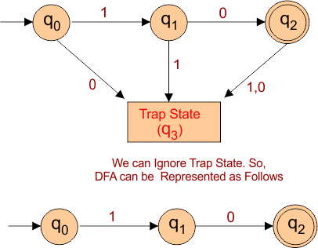
Design a DFA over ∑ = {0, 1} that accepts only the input string “10”.

Slide 14

Reflection Time: Quick Quiz
Let’s see what we have grasped.

Slide 15
Ensure attainment of LOs in alignment to the learning activities: outcomes (1-2)
LO1: Construct and analyze DFA
LO2: Differentiate DFA with other Automata Models

Slide 16
Discussion on the post session activities
Attempt all Questions of post lesson assessment.

Slide 17
Information about the next lesson
State transition diagram, Examples of languages accepted by DFA

Slide 18


Feedback and Queries

